Slide 1
Chapter 3
The Shell
1

Slide 2
Introduction to Shell:
When you log in, you are in one of five shells.
1. Bourne Shell – /bin/sh – Steve Bourne (On AT & T UNIX)
2. Bourne Again Shell – /bin/bash – Improved Bourne shell (On Linux)
3. C Shell – /bin/csh – Bill Joy (On BSD UNIX)
4. TC Shell – /bin/tcsh (On Linux)
5. Korn Shell – /bin/ksh – David Korn (On AT & T UNIX)
The system administrator determines which shell you start in.
1
Notes:
When we log into the system we are given a default shell. When the shell starts up it reads its startup files & set environment variables, command search paths & executes any commands specified in these files. The original shell was the Bourne shell.
1

Slide 3
The shell and its interpretive cycle:
You communicate with a UNIX system through a command program known as a shell.
The shell interprets the commands that you type on the keyboard.
There are many different shells available for UNIX computers and on some systems you can choose the shell in which you wish to work.
We can use shell commands to write simple programs (scripts) to automate many tasks.
1
Notes:
1

Slide 4
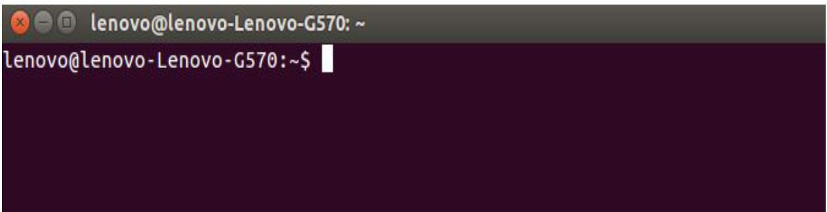
Shell issues the prompt & waits for you to enter a command.
After command is issued, shell scans command line for metacharacters & expands abbreviations to recreate a simplified command line.
Example:
cat > foo
rm -r *
1
Notes:
Then passed on the command line to kernel for execution. Shell waits for the command to complete. After the command execution, prompt reappears & shell returns to its waiting role to start the next cycle.
1

Slide 5
Pattern Matching – The wild-cards:
Listing all filenames beginning with chap.
The most obvious way is to specify all the filenames separately
ls chap chap01 cha02 chap03 chap04 chapx chapy chapz
If the filenames are similar as above, we can use the facilities offered by the shell of representing by a single pattern.
chap*
chap* represents all files beginning with chap.
1
Notes:
The metacharacters that are used to construct the generalized pattern for matching filenames belong to a category called wild-cards.
1

Slide 6
Pattern Matching – The wildcards
• You can substitute the * as a wildcard symbol for any number of
characters in any filename.
• If you type just * after a command, it stands for all files in the
current directory:
• You can mix the * with other characters to form a search pattern:
– ls a*.txt
The “?” wildcard stands for any single character:
– cp draft?.doc
1
Notes:
ls a*.txt will list all files that start with “a” and end in “.txt” cp draft?.doc will copy draft1.doc, draft2.doc, draftb.doc, etc.
1

Slide 7
The Shell’s Wild-cards:
Wild-Card | Matches
* | Any number of characters including none
? | A single character
[ijk] | A single character – either an i, j or k
[x-z] | A single character that is within the ASCII range of characters x and x
[!ijk] | A single character that is not an i,j or k (Not in C shell)
[!x-z] | A single character that is not within the ASCII range of the characters x and x (Not in C Shell)
{pat1,pat2…} | Pat1, pat2, etc. (Not in Bourne shell)
1
Notes:
1

Slide 8
More about wild-cards * and ?
There are two things that the * and ? Can’t match.
1. They don’t match a filename beginning with a dot, but they can match any number of embedded dots.
2. They don’t match the / in a pathname.
Hence both a dot (.) and / must be matched explicitly.
ls chap*
ls chap??
ls .???*
cd /usr?local //these characters don’t match the / in a pathname
1
Notes:
ls chap* list all files that begin with chap. ls chap?? list all files whose filenames are 6 character long and start with chap. ls .???* cd /usr?local change to /usr/local.
1

Slide 9
The character class:
The character class comprises a set of characters enclosed by the rectangular brackets [ and ], but it matches a single character in the class.
Eg:
$ ls data0[124]
$ ls chap[1-4]
$ ls file[x-z]
You can reverse the matching criteria by using ! As the first character in the class.
1
Notes:
ls data0[124] matches data01, data02 and data04 ls chap[1-4] matches chap1, chap2, chap3 and chap4 ls file[x-z] matches filex, filey and filez
1

Slide 10
$ ls *.[!co]
$ ls [!a-zA-Z]*
Matching dissimilar patterns:
If we wish to match totally dissimilar patterns, delimit the patterns with a comma and put curly braces around them.
To copy all the C & Java source programs from another directory, we can delimit the patterns with a comma and then put curly braces around them.
$ cp $HOME/prog_sources/*.{c,java} .
cp /home/srm/{progs, docs, data}/* . //Here, all files from 3 subdirectories like progs, docs and data, will be copied to the current directory.
1
Notes:
ls *.[!co] matches all filenames with a single-character extension but not .c and .o (Not in C Shell) ls [!a-zA-Z]* matches all filenames that don’t begin with an alphabetic character (Not in C Shell) Matching dissimilar patterns: This feature is not in Bourne shell.
1

Slide 11
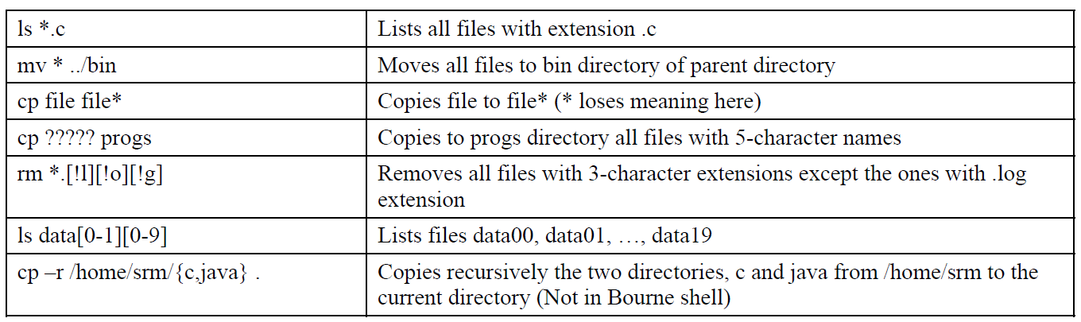
Summary:
1
Notes:
1

Slide 12
Escaping and Quoting:
Escaping: Providing a \ (backslash) before the wild-card to
remove its special meaning.
rm chap\*
cat chap0\[1-3\]
rm My\ Document.doc
Quoting: Enclosing the wild-card, or even the entire pattern, within quotes. Anything within these quotes (barring a few exceptions) are left alone by the shell and not interpreted.
1
Notes:
rm chap* will remove all files beginning with chap. To suppress the special meaning of *, use rm chap\* To list the contents of the file chap0[1-3] use cat chap0\[1-3\] To remove a file named My Document.doc, which has a space embedded use rm My\ Document.doc
1

Slide 13
Escaping:
✔ Escaping the *
✔ Escaping the [ ]
✔ Escaping the Space
✔ Escaping the \
1
Notes:
2)touch chap\[ ] , ls->chap[ ] , rm chap\[ ] , ls(no file of chap[ ]. 3) touch ch\ ap 4) touch ch\\ap
1

Slide 14
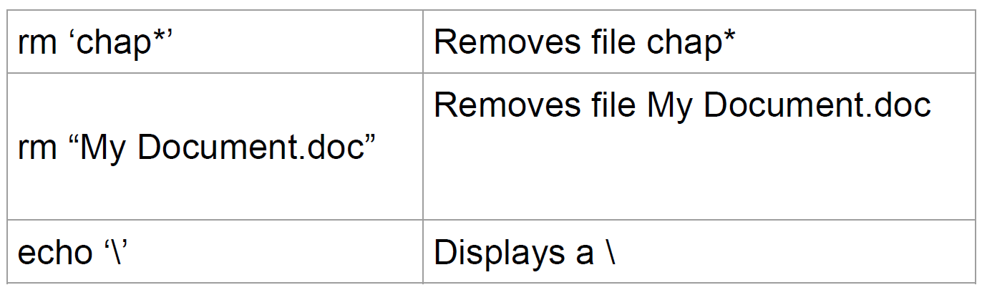
Quoting:
Escaping turns out to be a tedious affair when there are many
characters to protect. Quoting is a better solution.
Eg:
1
Notes:
Note: Single quotes protect all special characters. Double quotes are more permissive; they don’t protect $ and ` (backquote)
1

Slide 15
touch My Document.doc
ls → Displays Document.doc
touch My\Document.doc
ls → Displays MyDocument.doc
touch My\ Document.doc
ls → Displays My Document.doc
1

Slide 16
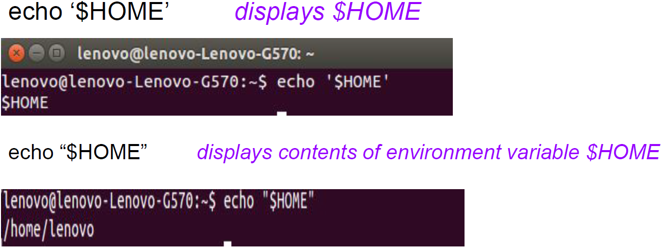
1
Notes:
1

Slide 17
The Backquotes:
Putting any Shell command in between backquotes executes the command.
Syntax: Here is the simple syntax to put any Shell command in between backquotes: var=`command`
Eg: The date command is executed here and the produced result is stored in DATE variable.
DATE=`date`
echo "Current Date: $DATE"
Upon execution, you will receive the following result −
Current Date: Thu Jul 2 05:28:45 MST 2009
1
Notes:
1

Slide 18
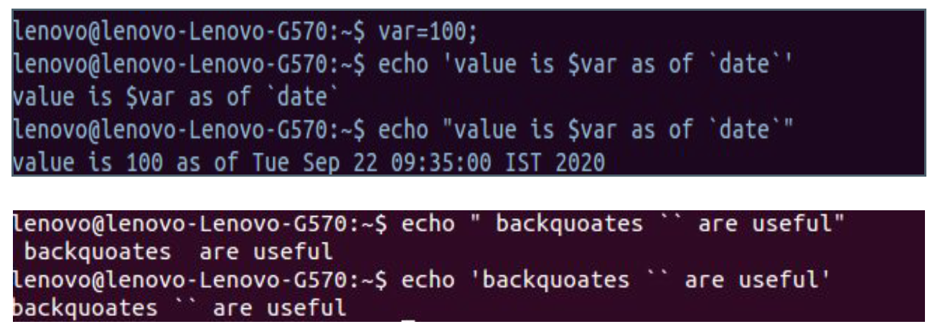
1
Notes:
1

Slide 19
Redirection: The three standard files:
The shell associates three files with the terminal.
Files are streams of characters which many commands see as input and output.
When a user logs in, the shell makes available three files representing three streams.
There are 3 standard streams:
a) Standard input
b) Standard output
c) Standard error
1
Notes:
Shell associates 3 files with the terminal – 2 for display and 1 for the keyboard. Std i/p: The file (stream) representing i/p connected to keyboard. Std o/p: file representing o/p is connected to display. Std error: File representing error messages that emanate from the command or shell, connected to display.
1

Slide 20
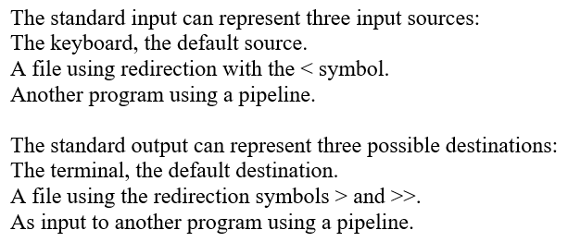
1
Notes:
1

Slide 21
Three Special Files:
Each of these three special files are represented by a number called a file descriptor.
A file is opened by using its pathname, but subsequent read and write operations identify the file by this file descriptor.
The kernel maintains a table of the file descriptors.
The first three slots are allocated to the three standard streams.
0 – Standard Input
1 – Standard Output
2 – Standard Error
1
Notes:
1

Slide 22
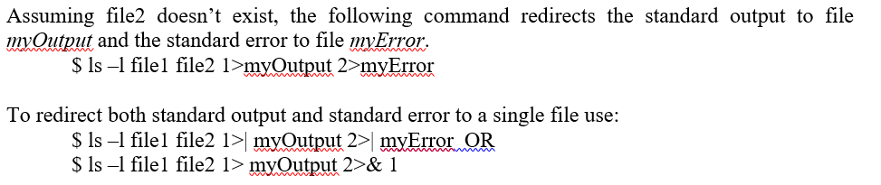
Eg:
1
Notes:
These descriptors are implicitly prefixed to the redirection symbols. Eg: 1)myoutput2 means std error
1

Slide 23
Standard Input:
When a command is used without arguments, it reads the file representing the standard input. It can represent three input sources
✔ The keyboard, the default source
✔ A file using redirection with the < symbol
✔ Another program using a pipeline
Example:
wc (without any arguments)
wc < sample.txt
ls | wc
cat file1 – file2
1
Notes:
Note: When a command takes input from multiple sources (Eg: a file and standard input) the – symbol must be used to indicate the sequence of taking input.
cat file1 – file2 First from file1, then standard input & then from file2
1

Slide 24
Taking input both from file & standard input:
cat – foo //1st from standard input & then from foo
cat foo – bar //1st from foo then standard input & then bar
1

Slide 25
Standard Output:
All commands displaying output on the terminal actually write to
the standard output file as a stream of characters.
There are three possible destinations of this stream:
✔ The terminal, the default destination
✔ A file using the redirection symbols > and >>
✔ As input to another program using a pipeline
Eg:
wc sample.txt
wc sample.txt > outputFile
who | wc –l
cat *.c > all_C_progs.txt
1
Notes:
1

Slide 26
Standard Error:
When we enter an incorrect command, or try to open
nonexistent file, certain diagnostic messages show up on the
screen. This is the standard error stream.
Eg: trying cat on a non existent file produces the error stream.
cat file 2>> errorfile
We can redirect this stream to a file. But, standard error cannot be redirected in the same way standard output can be (with > or >>).
To capture the standard error and redirect to a file we have to use 2> symbols.
Eg: cat file 2> errorfile
1
Notes:
We can redirect this stream to a file. But, standard error cannot be redirected in the same way standard output can be (with > or >>).
1

Slide 27
Filters:
UNIX commands can be grouped into 4 categories:
a) Directory-oriented commands like mkdir, rmdir and cd, and basic
file handling commands like cp, mv and rm use neither standard
input nor standard output.
2. Commands like ls, pwd, who etc. don’t read standard input but
they write to standard output.
3. Commands like lp that read standard input but don’t write to
standard output.
4. Commands like cat, wc, bc etc that use both standard input and
standard output.
1
Notes:
1

Slide 28
/dev/null AND /dev/tty:
/dev/null :
If you would like to execute a command but don’t like to see its
contents on the screen, you may wish to redirect the output to a
file called /dev/null.
It is a special file that can accept any stream without growing in
size. It’s size is always zero.
/dev/tty :
This file indicates one’s terminal.
In a shell script, if you wish to redirect the output of some select statements explicitly to the terminal.
In such cases you can redirect these explicitly to /dev/tty inside the script.
1
Notes:
1

Slide 29
Pipes:
With piping, the output of a command can be used as input (piped) to a subsequent command.
Syntax: $ command1 | command2
Eg: $ls -al | more
$who | sort | lpr
Eg: To print a list of users logged into the system without pipes,
$ who > file1
$ lpr file1
$wc –c *.c
$cat *.c | wc –c
1
Notes:
Syntax: Output from command1 is piped into input for command2. $wc –c *.c find total size of all C programs contained in the working directory. Also shows size of each file. cat *.c | wc –c to get total size only, to do this, we must make wc ignorant of its input source. wc acts on a stream this time, it displays a single value.
1

Slide 30
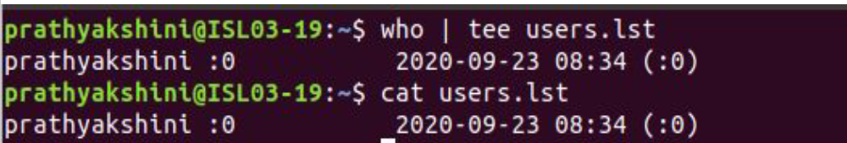
tee: Creating a tee:
tee is an external command that handles a character stream by duplicating its input.
tee sends standard input to specified file and also to standard
output.
It’s often used in command pipelines.
Eg: $who | tee users.lst
1
Notes:
It saves one copy in a file and writes the other to standard output. It is also a filter & can be placed anywhere in a pipeline. who | tee users.lst display the output of who and saves this output in a file as well.
1

Slide 31
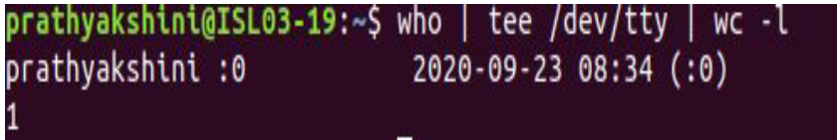
$who | tee /dev/tty | wc –l
Command Substitution:
While a pipe enables a command to obtain its standard input from the standard output of another command, the shell enables one or more command arguments to be obtained from the standard output of another command. This feature is called command substitution.
1
Notes:
$ who | tee /dev/tty | wc -l displays both the list of users and its count on the terminal.
1

Slide 32
Eg: $echo Current date and time is `date`
$echo “There are `ls | wc –l` files in the current directory”
The backquote is not interpreted by the shell if enclosed in single quotes.
1
Notes:
Eg: Here the output of command execution of date is taken as argument of echo. The shell executes the enclosed command & replaces the enclosed command line with the output of the command.
1

Slide 33
Shell Variables:
Global environment variables are set by your login shell and new programs and shells inherit the environment of their parent shell.
Local shell variables are used only by that shell and are not passed on to other processes.
Declaring local shell variable: variable=value. Its evaluation requires the $ as prefix to the variable name.
Eg: count=5
echo $count
5
$total=$count //Assign value of one variable to another variable echo $total
1
Notes:
Environmental variables are used to provide information to the programs. All shell variables will be of string type. Shell variables are initialized to null strings by default. Note: There should not be any space around =. i.e. if we say x=5 then the shell interprets x as command running with the =5 as argument!
1

Slide 34
Where to use Local Shell variables:
1. Setting pathnames: If a pathname is used several times in a
script, we can assign it to a variable and use it as an argument
to any command.
2. Using command substitution: We can assign the result of
execution of a command to a variable. The command to be
executed must be enclosed in backquotes.
3. Concatenating variables and strings: Two variables can be
concatenated to form a new variable.
1
Notes:
1

Slide 35
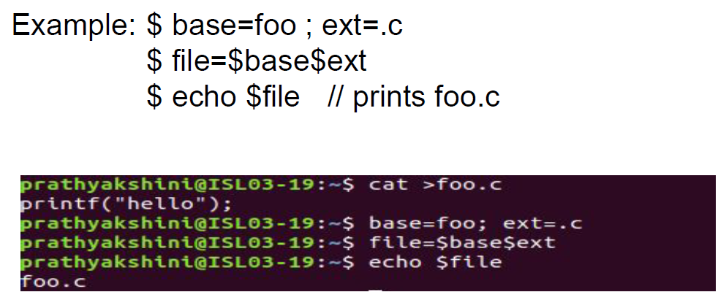
1
Notes:
1

Slide 36
Effects of Quoting and Escaping:
To assign a multiword string to a variable, quoting is preferred
than escaping.
message=You\ didn\’t\ enter\ the\ filename
O/P: message=“You didn’t enter the filename”
echo The average salary is \$1000
echo ‘The average salary is $1000’
O/P: The average salary is $1000
1
Notes:
Note: $ is evaluated by the shell when it is double-quoted.
1

Slide 37
Chapter 4: File Attributes
1
Notes:
1

Slide 38
Basic file attributes:
Listing File Attributes:
A file has a number of attributes (properties) that are stored in the inode.
It lists seven attributes of all files in the current directory they are:
a) File type and Permissions
b) Links
c) Ownership
d) Group ownership
e) File size
f) Last Modification date and time
g) File name
1
Notes:
File type & permissions are associated with each file. Links: number of file names maintained by the system. Does not mean many copies of file. Owner: file is created by him. Every user is attached to a group owner. If you change only the permissions or ownership of the file, the modification time remains unchanged.
1

Slide 39
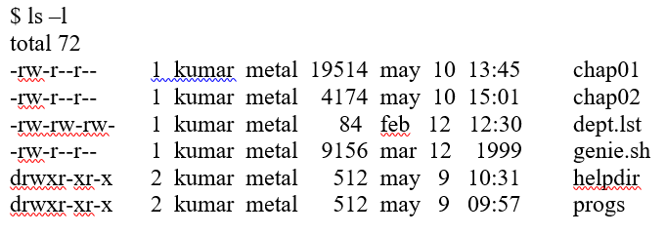

Eg:
Listing Directory Attributes:
Eg:
1
Notes:
ls -d will not list all subdirectories in the current directory
1

Slide 40
File Ownership:
Several users may belong to a single group, but the privileges of the group are set by the owner of the file and not by the group members.
When the system administrator creates a user account, he has to assign these parameters to the user:
a) The user-id (UID) – both its name and numeric representation
b) The group-id (GID) – both its name and numeric representation
File Permissions:
UNIX follows a three-tiered file protection system that determines a file’s access rights.
1
Notes:
When we create a file, you become its owner. Every owner is attached to a group owner.
1

Slide 41
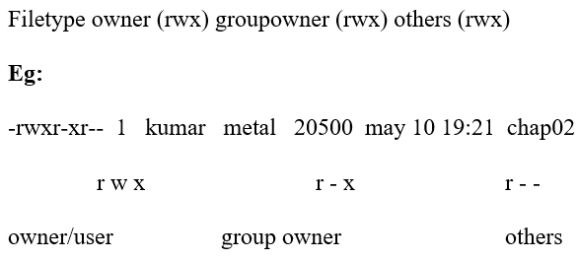
It is displayed in the following format:
1
Notes:
We can set different permission for 3 categories of users. 1st group has all 3 permissions. The 2nd group has a hyphen in the middle slot, which indicates the absence of write permission by the group owner of the file. The third group has the write and execute bits absent. This set of permissions is applicable to others.
1

Slide 42
Changing File Permissions:
A file or a directory is created with a default set of permissions, which can be determined by umask.
The command can be used in 2 ways:
a) In a relative manner by specifying the changes to the current permissions
b) In an absolute manner by specifying the final permissions
1
Notes:
Assume that the file permission for the created file is -rw-r--r--. Using chmod command, we can change the file permissions and allow the owner to execute his file.
1

Slide 43
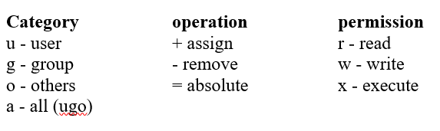
Relative Permissions:
Syntax: chmod category operation permission filename(s)
chmod takes an expression as its argument which contains:
a) user category (user, group, others)
b) operation to be performed (assign or remove a permission)
c) type of permission (read, write, execute)
1
Notes:
chmod only changes the permissions specified in the command line and leaves the other permissions unchanged.
1

Slide 44
Eg:
Initially,
-rw-r--r-- 1 kumar metal 1906 sep 23:38 xstart
chmod u+x xstart
-rwxr--r-- 1 kumar metal 1906 sep 23:38 xstart
chmod ugo+x xstart or
chmod a+x xstart or
chmod +x xstart
-rwxr-xr-x 1 kumar metal 1906 sep 23:38 xstart
1
Notes:
The command assigns (+) execute (x) permission to the user (u), other permissions remain unchanged.
1

Slide 45
chmod accepts multiple file names in command line:
chmod u+x note note1 note3
Let initially,
-rwxr-xr-x 1 kumar metal 1906 sep 23:38 xstart
chmod go-r xstart
Then, it becomes:
-rwx--x--x 1 kumar metal 1906 sep 23:38 xstart
1
Notes:
1

Slide 46
Absolute Permissions:
For each category, we add octal digits.
If we represent the permissions of each category by one octal digit, this is how the permission can be represented:
a) Read permission – 4 (octal 100)
b) Write permission – 2 (octal 010)
c) Execute permission – 1 (octal 001)
1
Notes:
Here no need to know current file permissions. We can set all 9 permissions explicitly. A string of three octal digits is used as an expression. The permission can be represented by one octal digit for each category.
1

Slide 47
Octal | Permissions | Significance
0 | - - - | no permissions
1 | - - x | execute only
2 | - w - | write only
3 | - w x | write and execute
4 | r - - | read only
5 | r – x | read and execute
6 | r w - | read and write
7 | r w x | read, write and execute
1
Notes:
We have 3 categories & 3 permissions for each category, so 3 octal digits can describe a file’s permissions completely. The most significant digit represents user & the least one represents others. chmod can use this three-digit string as the expression.
1

Slide 48
Using relative permission, we have,
chmod a+rw xstart
Using absolute permission, we have:
chmod 666 xstart
chmod 644 xstart
chmod 761 xstart
will assign all permissions to the owner, read and write permissions for the group and only execute permission to the others.
1
Notes:
777 signify all permissions for all categories, but still we can prevent file from being deleted. 000 signifies absence of all permissions for all categories, but still we can delete a file. It is the directory permissions that determine whether a file can be deleted or not. Only owner can change the file permissions. User cannot change other user’s file’s permissions. But the system administrator can do anything.
1

Slide 49
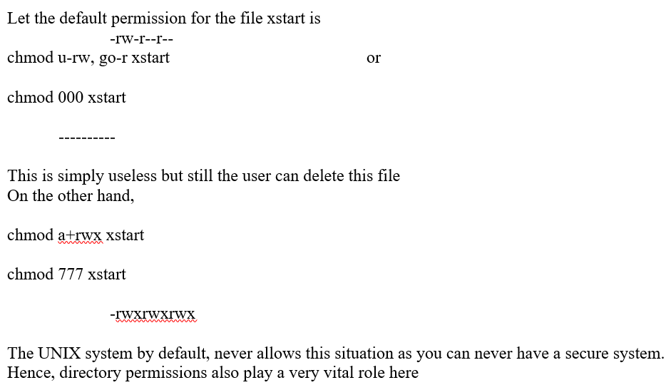
The Security Implications:
1

Slide 50
We can use chmod Recursively:
chmod -R a+x shell_scripts
Directory Permissions:
It is possible that a file cannot be accessed even though it has read permission, and can be removed even when it is write protected. The default permissions of a directory are,
rwxr-xr-x (755)
A directory must never be writable by group and others
1
Notes:
chmod -R a+x shell_scripts makes all the files and subdirectories found in the shell_scripts directory, executable by all users.
1

Slide 51
Eg:
mkdir c_progs
ls –ld c_progs
drwxr-xr-x 2 kumar metal 512 may 9 09:57 c_progs
1
Notes:
If a directory has write permission for group and others also, be assured that every user can remove every file in the directory. As a rule, you must not make directories universally writable.
1

Slide 52
Changing File Ownership:
Eg: Let kumar be the owner and metal be the group owner. If sharma copies a file of kumar, then sharma will become its owner and he can manipulate the attributes
chown changing file owner and chgrp changing group owner
On BSD, only system administrator can use chown
On other systems, only the owner can change both
1

Slide 53
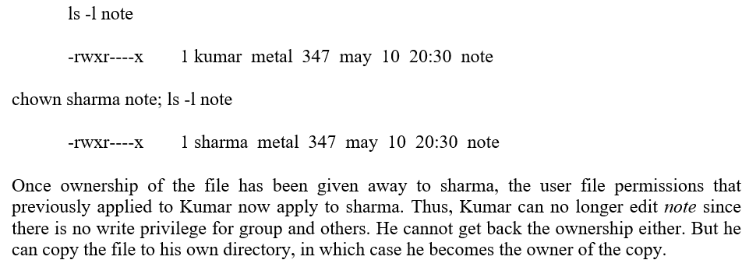
chown :
Eg:
1
Notes:
Changing ownership requires superuser permission, so use su command.
1

Slide 54
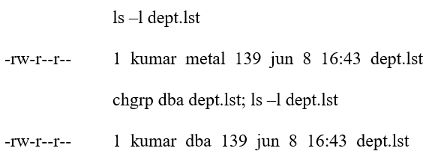
Chgrp:
1
Notes:
chgrp command changes the file’s group owner. Superuser permission is not required.
1

Slide 55
More File Attributes:
File Systems and inodes:
All attributes of a file except its name and contents are available in a table – inode (index node), accessed by the inode number.
The inode contains the following attributes of a file:
a) File type
b) File permissions
c) Number of links
d) The UID of the owner
e) The GID of the group owner
f) File size in bytes
g) Date and time of last modification
1
Notes:
The hard disk is split into distinct partitions, with a separate file system in each partition. Every file system has a directory structure headed by root. n partitions = n file systems = n separate root directories
1

Slide 56
h) Date and time of last access
i) Date and time of last change of the inode
j) An array of pointers that keep track of all disk blocks used by the file
ls -il tulec05
9059 -rw-r--r-- 1 kumar metal 51813 Jan 31 11:15 tulec05
Hard Links:
The link count is displayed in the second column of the listing. This count is normally 1, but the following files have 2 links:
-rwxr-xr-- 2 kumar metal 163 Jull 13 21:36 backup.sh
-rwxr-xr-- 2 kumar metal 163 Jul 13 21:36 restore.sh
1
Notes:
ls -il tulec05: To know inode number of a file. Here 9059 is the inode number and no other file can have the same inode number in the same file system.
1

Slide 57
Hard links are associating two or more file names with the same inode .
You can create one or more hard links for a single file.
ln: Creating Hard Links:
A file is linked with the ln command which takes two filenames as arguments (cp command).
The following command links emp.lst with employee:
ln emp.lst employee
ls -li emp.lst employee
29518 -rwxr-xr-x 2 kumar metal 915 may 4 09:58 emp.lst
29518 -rwxr-xr-x 2 kumar metal 915 may 4 09:58 employee
1
Notes:
Hard links cannot be created for directories & files on a different file system or partition. ln cmd creates both hard & soft link. It has syntax similar to the one used by cp. –i option to ls shows that they have the same inode number, meaning that they are actually one end the same file. Link count is normally 1 for unlinked files.
1

Slide 58
ln employee emp.dat ; ls -l emp*
29518 -rwxr-xr-x 3 kumar metal 915 may 4 09:58 emp.dat
29518 -rwxr-xr-x 3 kumar metal 915 may 4 09:58 emp.lst
29518 -rwxr-xr-x 3 kumar metal 915 may 4 09:58 employee
Use –f option to force the removal of the existing link before creation of the new one
Symbolic Links:
Symbolic link doesn’t have the file’s contents, but simply provides the pathname of the file that actually has the contents.
Command to create a Soft link: ln -s [original filename] [link name]
1
Notes:
ln employee emp.dat ; ls -l emp* You can link multiple files, but then the destination filename must be a directory. A file is considered to be completely removed from the file system when its link count drops to 0.
1

Slide 59
If we change the name of the original file then all the soft links for that file become dangling.
ln -s note note.sym
ls -li note note.sym
9948 -rw-r--r-- 1 kumar group 80 feb 16 14:52 note
9952 lrwxrwxrwx 1 kumar group 4 feb16 15:07note.sym ->note
Removing note.sym won’t affect much because we can easily recreate the link. But if we remove note, we would lose the file containing the data.
In that case, note.sym would point to a nonexistent file and become a dangling symbolic link.
1
Notes:
Eg: 1 indicate symbolic link file category. -> indicates note.sym contains the pathname for the filename note. Size of symbolic link is only 4 bytes; it is the length of the pathname of note.
1

Slide 60
Symbolic links can also be used with relative pathnames.
Unlike hard links, they can also span multiple file systems and also link directories.
A symbolic link has an inode number separate from the file that it points to.
Difference between Hard links and soft links:
1
Notes:
1

Slide 61
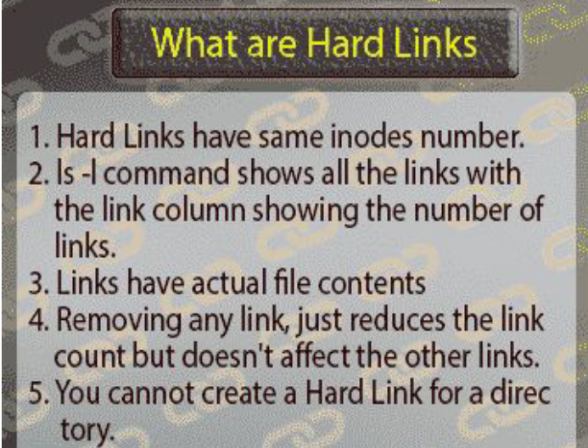
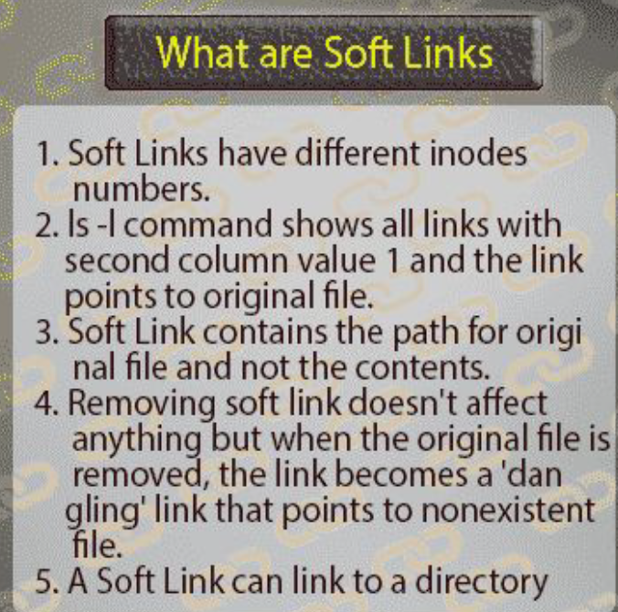
The Directory:
A directory has its own permissions, owners and links.
ls -l -d progs
drwxr-xr-x 2 kumar metal 320 may 9 09:57 progs
1
Notes:
Default permissions are different from those of ordinary files. User has all permissions, and group and others have read and execute permissions only.
1

Slide 62
Read permission:
ls reads the directory to display filenames, if a directory’s read permission is removed, ls wont work.
Eg: Consider removing the read permission first from the directory progs:
ls -ld progs
drwxr-xr-x 2 kumar metal 128 jun 18 22:41 progs
chmod -r progs ; ls progs
progs: permission denied
1
Notes:
Read permission for a directory means that the list of filenames stored in that directory is accessible.
1

Slide 63
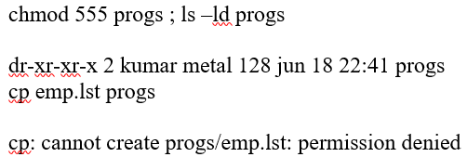
Write permission:
Write permission for a directory implies that you are permitted to create or remove files in it.
To try that out, restore the read permission and remove the write permission from the directory before you try to copy a file to it.
Eg:
1
Notes:
We can’t write to a directory file. Only the kernel can do that. If that were possible, any user could destroy the integrity of the file system.
1

Slide 64
The write permission for a directory determines whether we can create or remove files in it because these actions modify the directory
Whether we can modify a file depends on whether the file itself has write permission. Changing a file doesn't modify its directory entry
Execute permission:
If a single directory in the pathname doesn’t have execute permission, then it can’t be searched for the name of the next directory.
A directory has to be searched for the next directory, so the cd command won’t work if the search permission for the directory is turned off.
1
Notes:
Execute privilege of a directory is often referred to as the search permission.
1

Slide 65
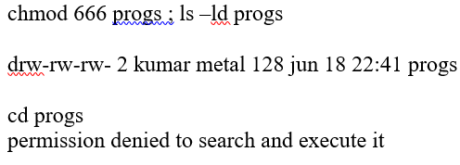
Eg:
umask: DEFAULT FILE AND DIRECTORY PERMISSIONS:
The UNIX system has the following default permissions for all files and directories:
rw-rw-rw- (octal 666) for regular files
rwxrwxrwx (octal 777) for directories
1
Notes:
When we create files and directories, the permissions assigned to them depend on the system’s default setting.
1

Slide 66
The default is transformed by subtracting the user mask from it to remove one or more permissions.
We can evaluate the current value of the mask by using umask without arguments:
$ umask
022
This becomes 644 (666-022) for ordinary files and 755 (777-022) for directories umask 000.
Modification and Access Times:
A UNIX file has three time stamps associated with it. Among them, two are:
Time of last file modification ls -l
Time of last access ls –lu
1
Notes:
Access time is displayed when ls -l is combined with the -u option.
1

Slide 67
Touch Command: changing the time stamps:
To set the modification and access times to predefined values.
Syntax: touch options expression filename(s)
Eg: touch emp.lst (without options and expression)
touch command (without options but with expression) can be used. The expression consists of MMDDhhmm (month, day, hour and minute).
touch 03161430 emp.lst ; ls -l emp.lst
-rw-r--r-- 1 kumar metal 870 mar 16 14:30 emp.lst
1
Notes:
Eg: When touch is used without options but with expression it sets both time to current time. touch 03161430 emp.lst ; ls -l emp.lst expression consists of MMDDhhmm (month, day, hour and minute
<number>

Slide 68
ls -lu emp.lst
-rw-r--r-- 1 kumar metal 870 mar 16 14:30 emp.lst
Eg: touch -m 02281030 emp.lst ; ls -l emp.lst
-rw-r--r-- 1 kumar metal 870 feb 28 10:30 emp.lst
touch -a 01261650 emp.lst ; ls -lu emp.lst
-rw-r--r-- 1 kumar metal 870 jan 26 16:50 emp.lst
find : locating files:
Syntax: find path_list selecton_criteria action
The path_list comprises one or more subdirectories separated by white space. There can also be a host of selection_criteria that you use to match a file, and multiple actions to dispose of the file.
1
Notes:
-m for changing modification time. -a for changing access time. Find: It look for files matching some criteria, and then takes some action on the selected files. Syntax: Recursively examines all files specified in path_list. It then matches each file for one or more selection-criteria. It takes some action on those selected files
<number>

Slide 69
Thank You
1

